Slide 1
Chapter 7
User-Defined Simple Data Types, Namespaces, and the string Type

Slide 2
Objectives (1 of 2)
In this chapter, you will:
Learn how to create and manipulate your own simple data type—called the enumeration type
Explore how the assignment statement, and arithmetic and relational operators work with enum types
Learn how to use for loops with enum types
Learn how to input data into an enum type
Learn how to output data stored in an enum type

Slide 3
Objectives (2 of 2)
Explore how to write functions to process enum types
Learn how to declare variables when defining the enumeration type
Become familiar with anonymous types
Become familiar with the typedef statement
Learn about the namespace mechanism
Explore the string data type, and learn how to use string functions to manipulate strings

Slide 4
Enumeration Type (1 of 5)
A data type is a set of values with a set of operations on them
Enumeration type is a simple data type created by the programmer
To define an enumeration type, you need:
A name for the data type
A set of values for the data type
A set of operations on the values

Slide 5

Enumeration Type (2 of 5)
You can specify the name and the values, but not the operations
The syntax for enumeration type is:
value1, value2, … are identifiers called enumerators
List specifies the ordering:
value1 < value2 < value3 <...

Slide 6
Enumeration Type (3 of 5)
The enumeration type is an ordered set of values
Default value assigned to enumerators starts at 0
A value used in one enumeration type cannot be used by another in the same block
Same rules apply to enumeration types declared outside of any blocks

Slide 7
Enumeration Type (4 of 5)
EXAMPLE 7-1
The statement:
enum colors {BROWN, BLUE, RED, GREEN, YELLOW};
defines a new data type called colors, and the values belonging to this data type are BROWN, BLUE, RED, GREEN, and YELLOW.
EXAMPLE 7-2
The statement:
enum standing {FRESHMAN, SOPHOMORE, JUNIOR, SENIOR};
defines standing to be an enumeration type. The values belonging to standing are FRESHMAN, SOPHOMORE, JUNIOR, and SENIOR.

Slide 8
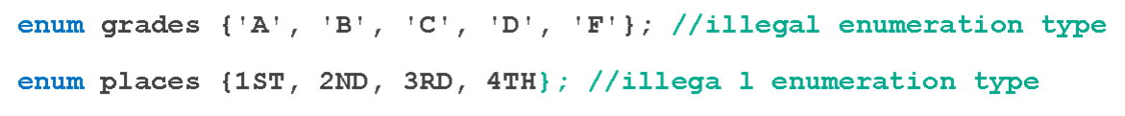
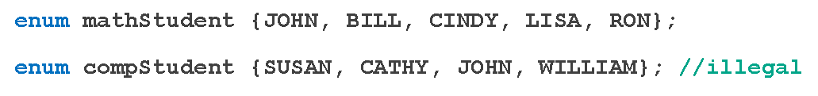
Enumeration Type (5 of 5)
EXAMPLE 7-3
Consider the following statements:
These are illegal enumeration types because none of the values is an identifier. The following, however, are legal enumeration types:
enum grades {A, B, C, D, F};
enum places {FIRST, SECOND, THIRD, FOURTH};
EXAMPLE 7-4
Consider the following statements:
Suppose that these statements are in the same program in the same block. The second enumeration type, compStudent, is not allowed because the value JOHN was used in the previous enumeration type mathStudent.

Slide 9

Declaring Variables
Syntax
Example
enum sports {BASKETBALL, FOOTBALL, HOCKEY, BASEBALL, SOCCER,
VOLLEYBALL};
Can declare variables such as:
sports popularSport, mySport;

Slide 10
Assignment
Values can be stored in enumeration data types:
popularSport = FOOTBALL;
Stores FOOTBALL into popularSport

Slide 11


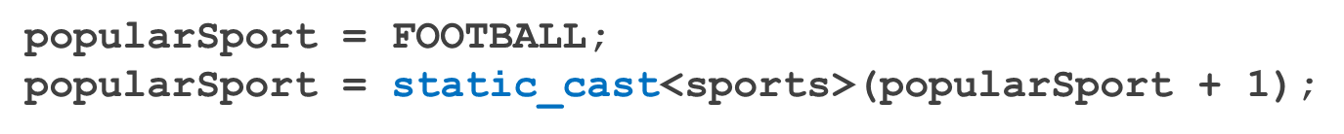
Operations on Enumeration Types
No arithmetic operations are allowed on enumeration types
++ and -- are illegal, too
The solution is applying the cast operator

Slide 12
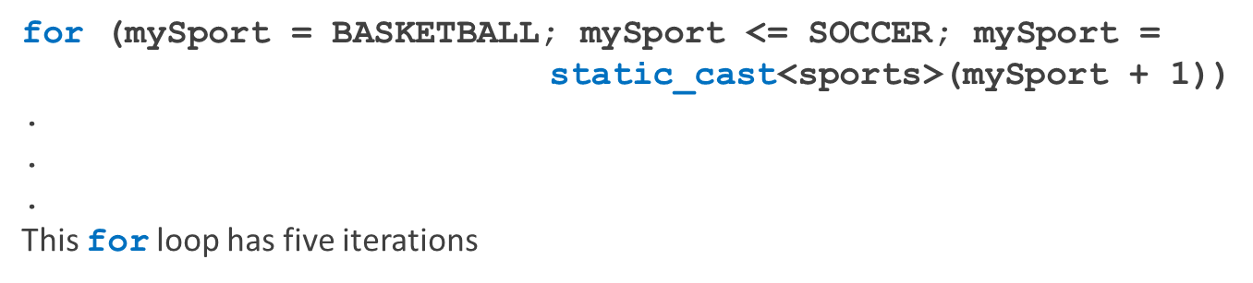
Relational Operators
An enumeration type is an ordered set of values:
FOOTBALL <= SOCCER is true
HOCKEY > BASKETBALL is true
BASEBALL < FOOTBALL is false
An enumeration type is an integral data type and can be used in loops:

Slide 13
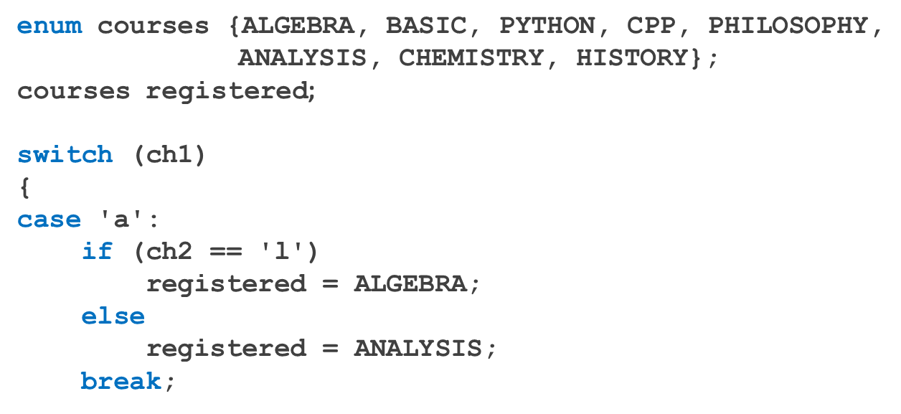
Input /Output of Enumeration Types
An enumeration type cannot be input/output (directly)
Can input and output indirectly – refer to code segments below:

Slide 14
Functions and Enumeration Types
Enumeration types can be passed as parameters to functions either by value or by reference
A function can return a value of the enumeration type

Slide 15
Declaring Variables When Defining the Enumeration Type
Can declare variables of an enumeration type when you define an enumeration type:
enum grades {A, B, C, D, F} courseGrade;

Slide 16
Anonymous Data Types (1 of 2)
Anonymous type values are directly specified in the declaration, with no type name
Example:
enum {BASKETBALL, FOOTBALL, BASEBALL, HOCKEY} mySport;

Slide 17
Anonymous Data Types (2 of 2)
Drawbacks:
Cannot pass/return an anonymous type to/from a function
Values used in one type can be used in another, but are treated differently:
enum {ENGLISH, FRENCH, SPANISH, GERMAN, RUSSIAN} languages;
enum {ENGLISH, FRENCH, SPANISH, GERMAN, RUSSIAN} foreignLanguages;
This statement is illegal:
Best practices: to avoid confusion, define an enumeration type first, then declare variables

Slide 18
typedef Statement (1 of 2)
The typedef statement is used to create synonyms or aliases to a data type
The syntax of the typedef statement is:
typedef does not create any new data types
Only creates an alias to an existing data type

Slide 19
typedef Statement (2 of 2)
The typedef statement is used to create synonyms or aliases to a data type
The syntax of the typedef statement is:
typedef does not create any new data types
Only creates an alias to an existing data type

Slide 20
Namespaces (1 of 6)
ANSI/ISO standard C++ was officially approved in July 1998
Most recent compilers are compatible with ANSI/ISO standard C++
For the most part, standard C++ and ANSI/ISO standard C++ are the same
However, ANSI/ISO Standard C++ has some features not available in Standard C++

Slide 21
Namespaces (2 of 6)
Global identifiers in a header file used in a program become global in the program
A syntax error occurs if a program’s identifier has the same name as a global identifier in the header file
The same problem can occur with third-party libraries
Common solution: third-party vendors begin their global identifiers with _ (underscore)
Do not begin identifiers in your program with _

Slide 22
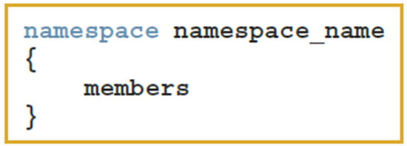
Namespaces (3 of 6)
ANSI/ISO Standard C++ attempts to solve this problem with the namespace mechanism
The general syntax of the statement namespace is:
where members consist of variable declarations, named constants, functions, or another namespace

Slide 23
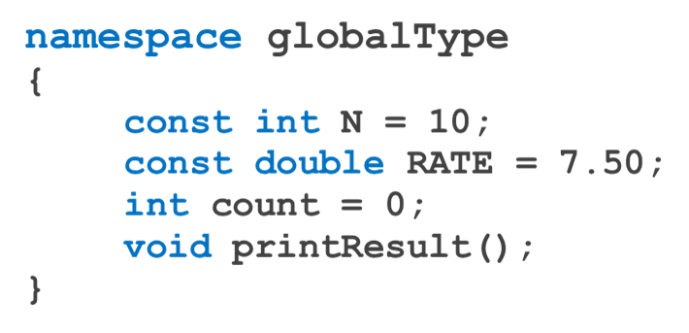
Namespaces (4 of 6)
EXAMPLE 7-8
The statement:
defines globalType to be a namespace with four members: named constants N and RATE, the variable count, and the function printResult.

Slide 24



Namespaces (5 of 6)
A namespace member has scope local to the namespace
A namespace member can be accessed outside the namespace
The general syntax for accessing a namespace member is:
ANSI/ISO Standard C++ provides the use of the statement using

Slide 25
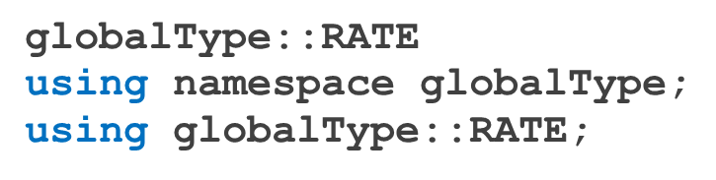
Namespaces (6 of 6)
Examples with namespaces
After the using statement, it is not necessary to put the
Unless a namespace member and a global identifier or a block identifier have the same name

Slide 26
string Type
To use data type string, a program must include the header file string
A string is a sequence of zero or more characters
The first character is in position 0
The second character is in position 1, etc.
Binary operator + performs the string concatenation operation
Array subscript operator [] allows access to an individual character in a string

Slide 27
Additional string Operations
The data type string has a data type, string::size_type, and a named constant, string::npos, defined as follows:
string::size_type | An unsigned integer (data) type
string::npos | The maximum value of the (data) type string::size_type, a number such as 4294967295 on many machines

Slide 28
Example 7-18: swap Function
EXAMPLE 7-18
The swap function is used to swap—that is, interchange—the contents of two string variables.
Suppose you have the following statements:
string str1 = "Warm";
string str2 = "Cold";
After the following statement executes, the value of str1 is "Cold" and the value of
str2 is "Warm".
str1.swap(str2);

Slide 29
Problem: Temperature Conversion using Namespaces
Write a program that defines two namespaces: one for converting temperatures and another for displaying temperatures. The first namespace, TemperatureConversion, will contain functions to convert Celsius to Fahrenheit and Fahrenheit to Celsius. The second namespace, TemperatureDisplay, will contain functions to display the converted temperatures.

Slide 30
Quick Review (1 of 3)
Enumeration type: set of ordered values
Reserved word enum creates an enumeration type
No arithmetic operations are allowed on the enumeration type
Relational operators can be used with enum values
Enumeration type values cannot be input or output directly
Enumeration types can be passed as parameters to functions by value or by reference

Slide 31
Quick Review (2 of 3)
Anonymous type: a variable’s values are specified without any type name
Reserved word typedef creates synonyms or aliases to previously defined data types
The namespace mechanism is a feature of ANSI/ISO Standard C++
A namespace member is usually a named constant, variable, function, or another namespace
Scope of a namespace member is local to namespace

Slide 32
Quick Review (3 of 3)
using statement simplifies access to namespace members
A string is a sequence of zero or more characters
Strings in C++ are enclosed in ""
The first character of a string is in position 0
In C++, [] is the array subscript operator

